Slide 1

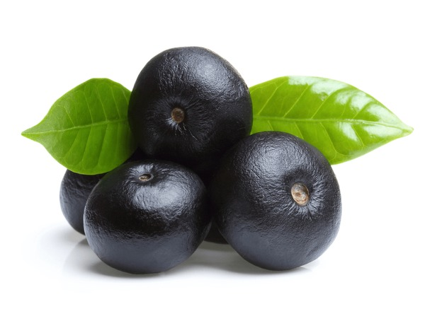
Revolutionizing Cancer Treatment: Harnessing the Power of Genetically Potential
Acai Berries using ML Algorithms
Presented By:
KVV Mathimithra
V Merlin Vensiya
Guided By:
Dr R Beulah Jayakumari, HoD IT, Tagore Engineering College

Slide 2
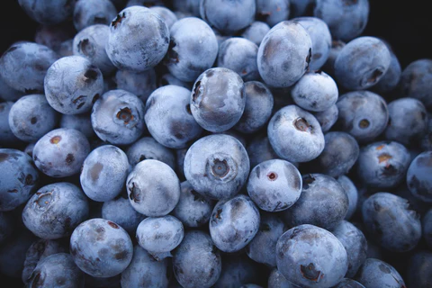
PROBLEM STATEMENT:
The escalating incidence of cancer necessitates innovative, cost-effective therapeutic alternatives. Acai berries, rich in antioxidants, demonstrate significant potential in treating colon, bladder, and breast cancers.
However, in India, the cultivation and utilization of acai berries are constrained by inadequate agricultural practices and technological adoption.

Slide 3
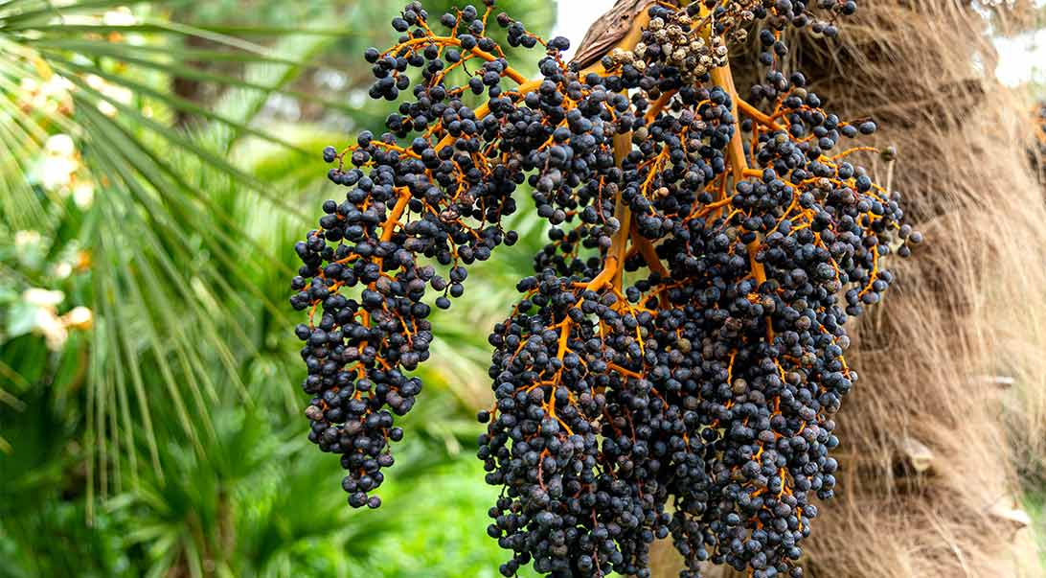
OBJECTIVE
The objective is to investigate the therapeutic potential of acai berries as a bioactive natural remedy for oncological applications, with a specific focus on the chemo-preventive and chemotherapeutic effects against colon, bladder, and breast carcinomas.
The proposed idea evaluates the feasibility of cultivating acai berries in India by employing advanced agronomic techniques, such as machine learning algorithms for predictive analytics and precision agriculture methodologies.
sensors
ML
MODEL
device
DECISION
MAKING
REQUIRED
ACTION
Data
collection
DATA
INTREPRETATION

Slide 4
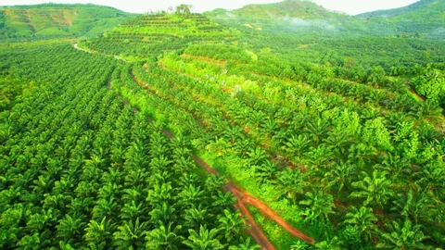
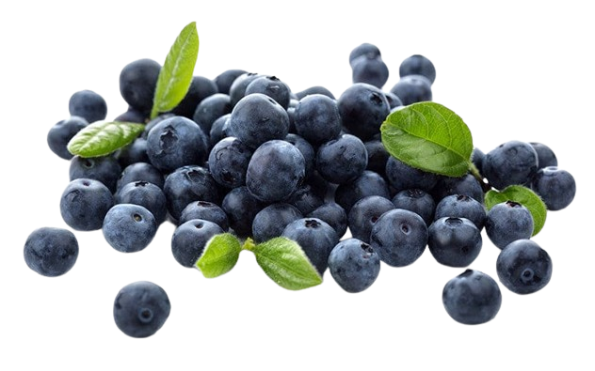
WHY ACAI BERRY ?
Nutritional content of 100 grams
Calories: Approximately 70-80 kcal
Fat: Around 4-5 grams
Saturated fat: Less than 1 gram
Carbohydrates: About 4-5 grams
Dietary fiber: Around 2 grams
Sugars: Less than 1 gram
Protein: About 1-2 grams
Vitamins and minerals :
Vitamin A: 750 IU
Vitamin C: 10 mg
Calcium: 20 mg
Iron: 0.5 mg
Improves Mental Function
Antioxidant Loading
Anti Cancer Effects
Boosts Energy
Fiber Packed
High level of Vitamins
ORAC Value
Acai berries, through their antioxidant anthocyanins, anti-inflammatory compounds, anti-proliferative effects on cancer cells, induction of apoptosis, and immune system modulation, contribute to potential therapeutic benefits against cancer.

Slide 5
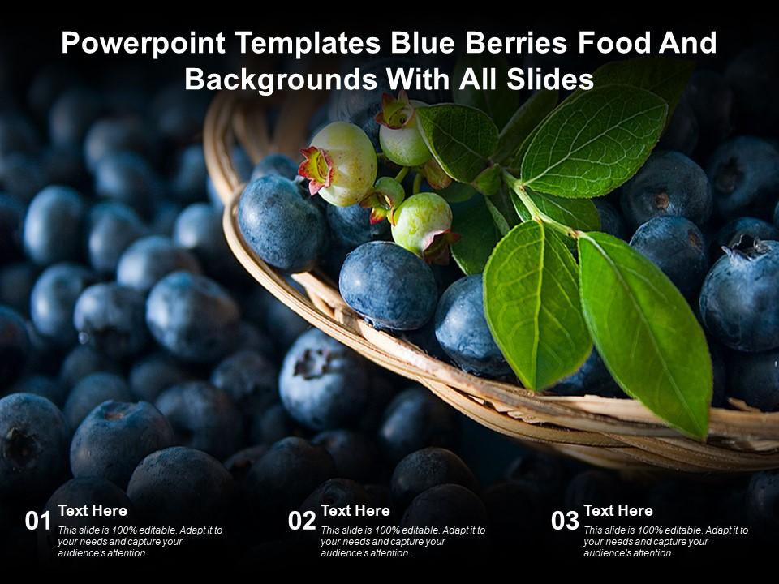





WORKFLOW I OF THE MODEL
Genetic Sequencing of Acai Berry Genome
Identification of Anti-Cancer Genes
Bioinformatics Analysis
Pathway
Analysis
Transforming genome
NGS
Technology
Gene-to-KEGG Mapping
Flavonoid Biosynthesis Pathway
Utilising CRISPR/Cas9 for genome
Pointers

Slide 6
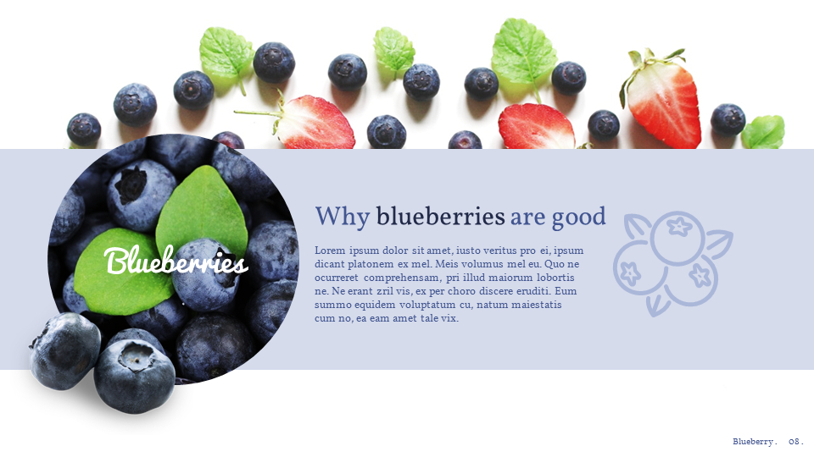
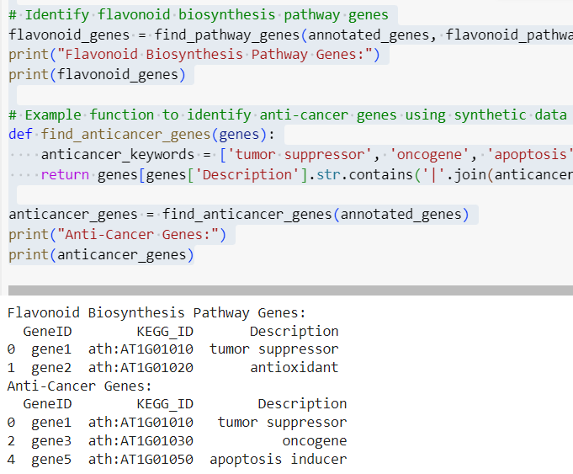
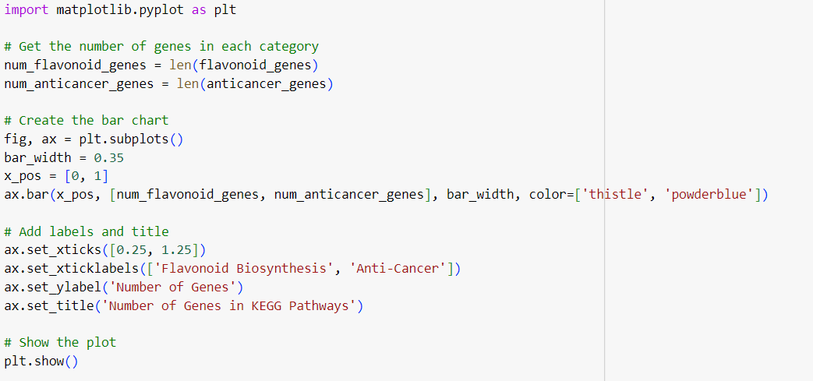
PREDICTIVE ANALYSIS MODEL

Slide 7
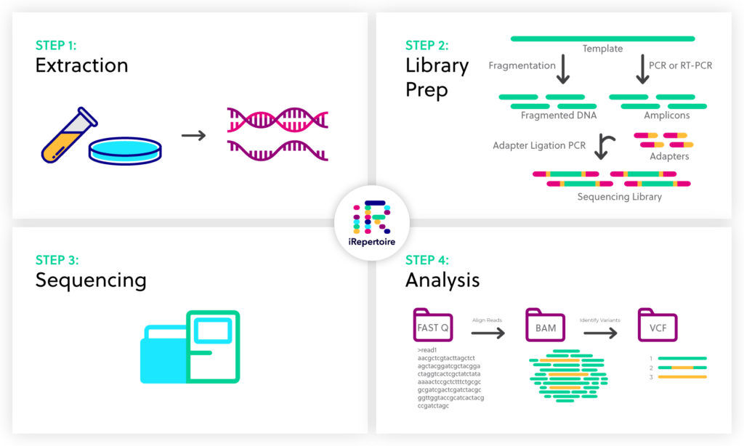
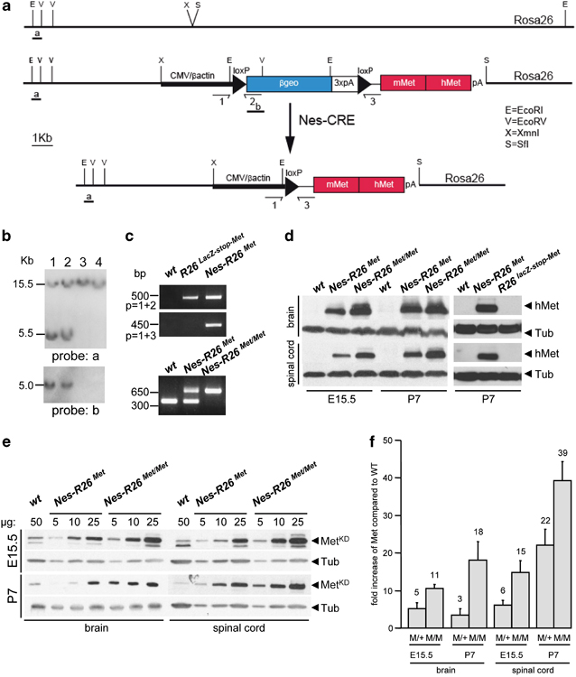
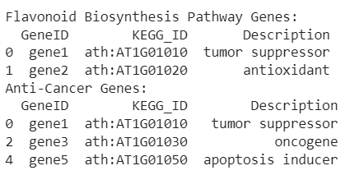
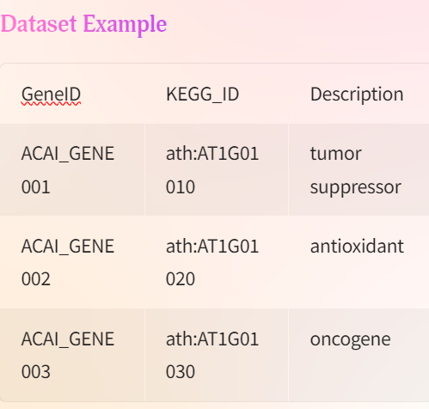
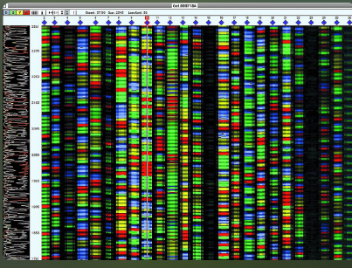
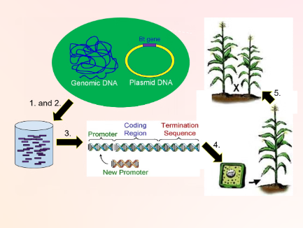
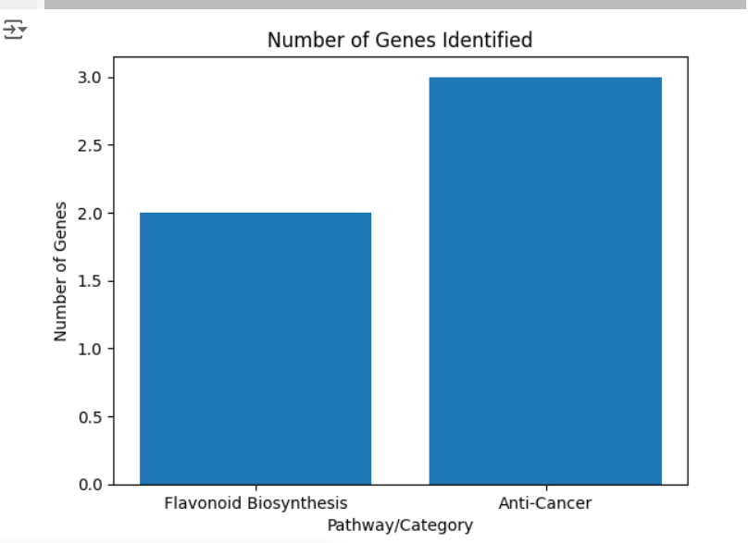
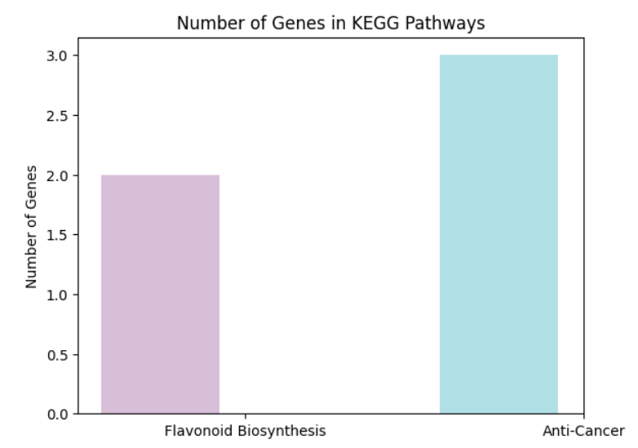
SAMPLE DATA PREDICTION & RESULTS
WITHOUT ML
WITH ML

Slide 8

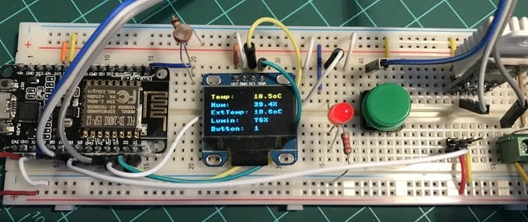

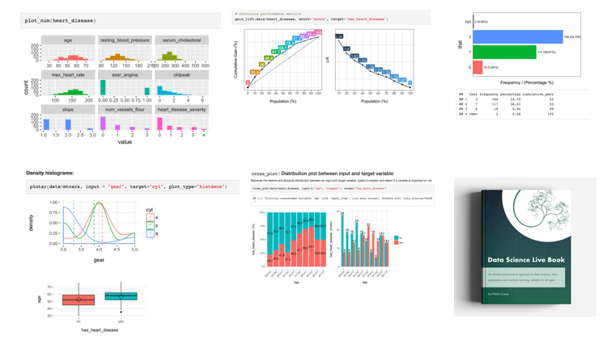
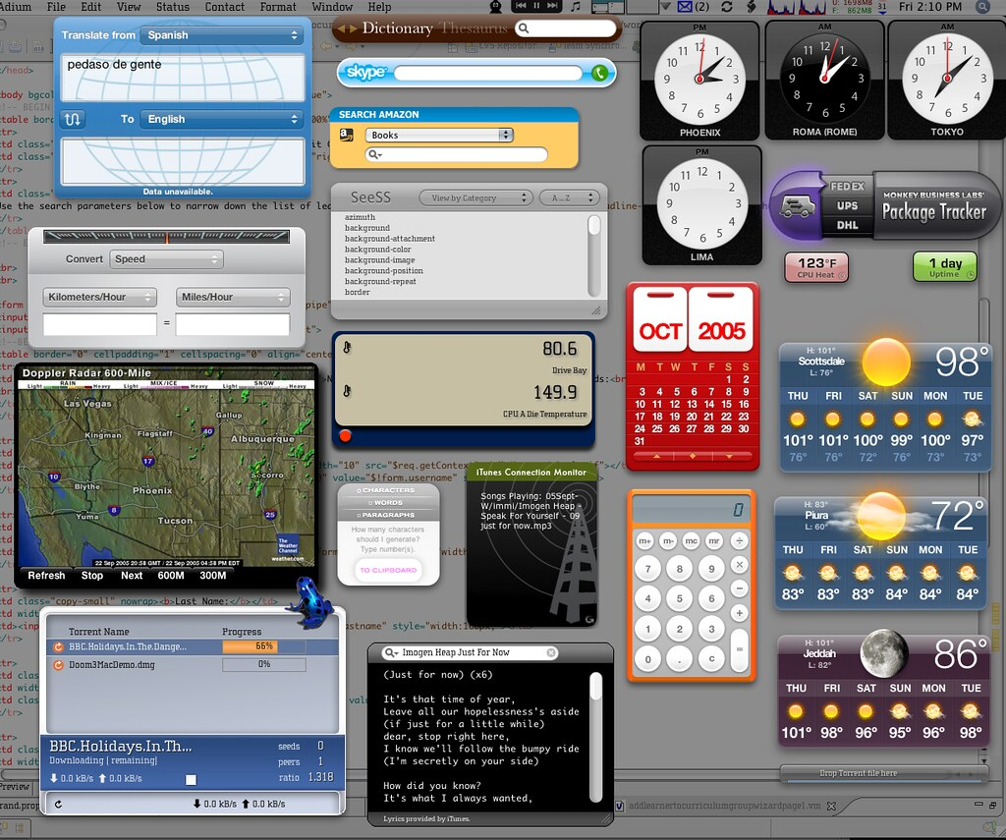
WORKFLOW II OF THE MODEL
Multiple sensors will
Collect the information
Regarding the soil
The collected data is
analyzed under ML
algorithms to obtain
the data models.
The data model helps
In making the decision
The device instructs
The farmer about the
Accurate yield
possibility

Slide 9
PARAMETERS USED:
Soil Type: Type of soil (e.g., 'Loamy', 'Clay', etc.)
Weather Conditions: Weather conditions (e.g., 'Tropical', 'Humid', etc.)
Year: Year of the data entry
Plant Density: Plant density in plants per hectare
Soil pH: pH level of the soil
Nutrients Level: Level of nutrients in the soil (e.g., 'High', 'Medium', 'Low')
Pest Control: Whether pest control measures are taken ('Yes' or 'No')
Fertilizer Type: Type of fertilizer used (e.g., 'Organic', 'Chemical', etc.)
Irrigation Type: Type of irrigation used (e.g., 'Drip', 'Flood', etc.)
Harvest Time: Timing of the harvest (e.g., 'Early', 'Mid', 'Late')
Yield: Predicted yield in kg/h
Market Price: Predicted market price in INR/kg
Cancer Prevention Study Findings: Predicted study findings regarding cancer prevention ('Positive', 'Negative', or 'Neutral')

Slide 10
Data Preprocessing
Steps Taken:
Handling missing values.
Encoding categorical variables.
Splitting the dataset into training and testing sets.
Model Selection
Chosen Algorithms:
Gradient Boosting Regressor for yield and market price prediction.
Gradient Boosting Classifier for cancer prevention study findings.

Slide 11
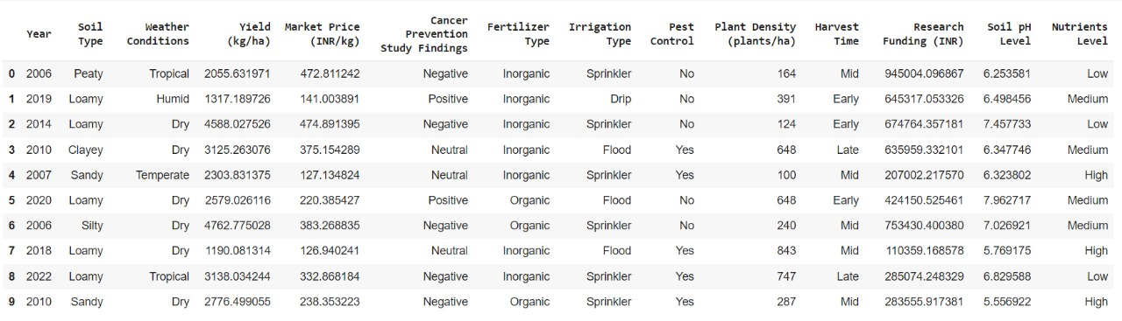
SAMPLE DATASET

Slide 12
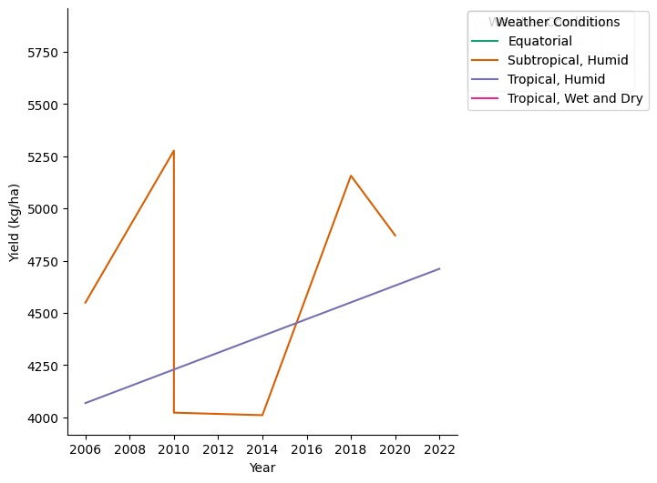
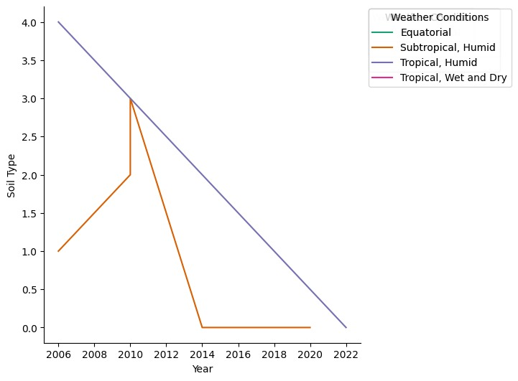
PREDICTIVE ANALYSIS MODEL
Predicted information for Acai berry cultivation:
Year of data collection, soil type (e.g., Sandy Loam), suitable weather conditions, yield (kg/ha), market price (INR/kg), and findings on cancer prevention.

Slide 13
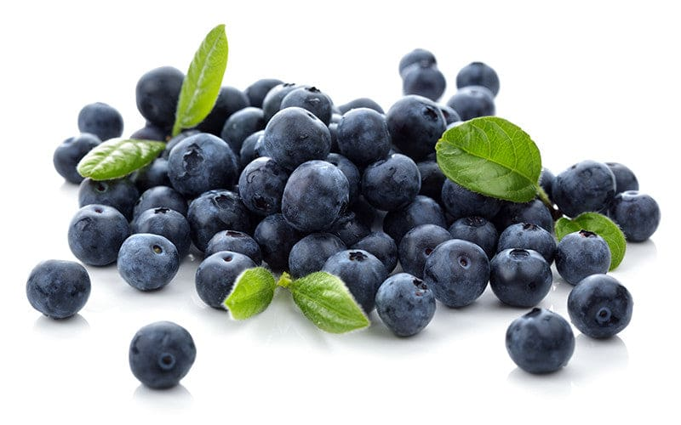
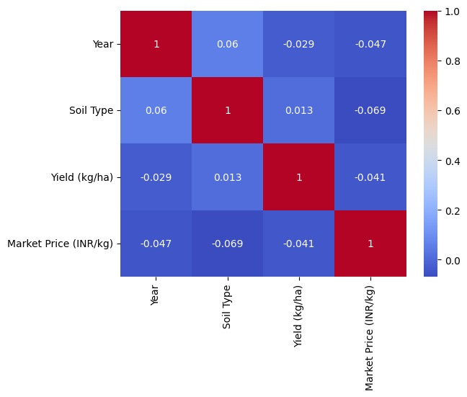
PRECISION RESULTS
Predicting Yield: You can use the dataset to predict the yield of Acai berries based on factors such as soil type, weather conditions, and year.
Predicting Market Price: You can predict the market price of Acai berries.
Classifying Study Findings: You can classify the cancer prevention study findings based on yield, soil type, weather conditions, and year.
Gradient Boosting Regressor - algorithm
RESULTS:
Best parameters: {'learning_rate': 0.01, 'max_depth’: 3, 'n_estimators': 100}
XGBoost - Mean Squared Error: 369205.5999311864
XGBoost - Root Mean Squared Error: 607.6229093205641
XGBoost - R-squared: 0.7771466931720816

Slide 14
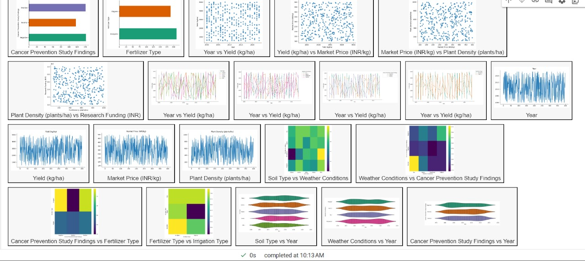
PRECISION RESULTS

Slide 15
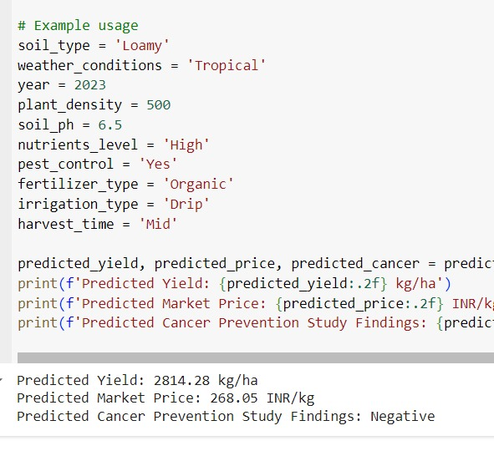
PREDICTED OUTPUT MODEL

Slide 16
Summary:
The models successfully predict acai berry yield and market price.
Effective classification of cancer prevention findings.
Potential applications in optimizing agricultural practices and health research.
Future Enhancements:
Adding more features like soil moisture, pest infestation levels.
Exploring advanced machine learning techniques like deep learning.
Developing a real-time prediction system for farmers and researchers.

Slide 17

REFERENCES
Allali et al., "Human microbiota research in Africa: A systematic review reveals gaps and priorities for future research", Microbiome, vol. 9, no. 1, 2021.Show in Context CrossRef Google Scholar
S. L. McLellan, J. C. Fisher and R. J. Newton, "The microbiome of urban waters", Int. Microbiol.: Official J. Spanish Soc. Microbiol., vol. 18, no. 3, pp. 141-149, 2015.Show in Context Google Scholar
X. Ding, W. Lan and J.-D. Gu, "A review on sampling Techniques and analytical methods for microbiota of cultural properties and historical architecture", Appl. Sci., vol. 10, no. 22, pp. 8099, 2020.Show in Context CrossRef Google Scholar
Y. S. Bukin, Y. P. Galachyants, I. Morozov, S. Bukin, A. Zakharenko and T. Zemskaya, "The effect of 16S rRNA region choice on bacterial community metabarcoding results", Sci. Data, vol. 6, no. 1, pp. 1-14, 2019.Show in Context CrossRef Google Scholar
B. Yang, Y. Wang and P.-Y. Qian, "Sensitivity and correlation of hypervariable regions in 16S rRNA genes in phylogenetic analysis", BMC Bioinf., vol. 17, no. 1, pp. 1-8, 2016.Show in Context CrossRef Google Scholar

Slide 18
Thank You
"Integrating machine learning in acai berry production and research can revolutionize the use of this superfruit in cancer treatment”

